Slide 1

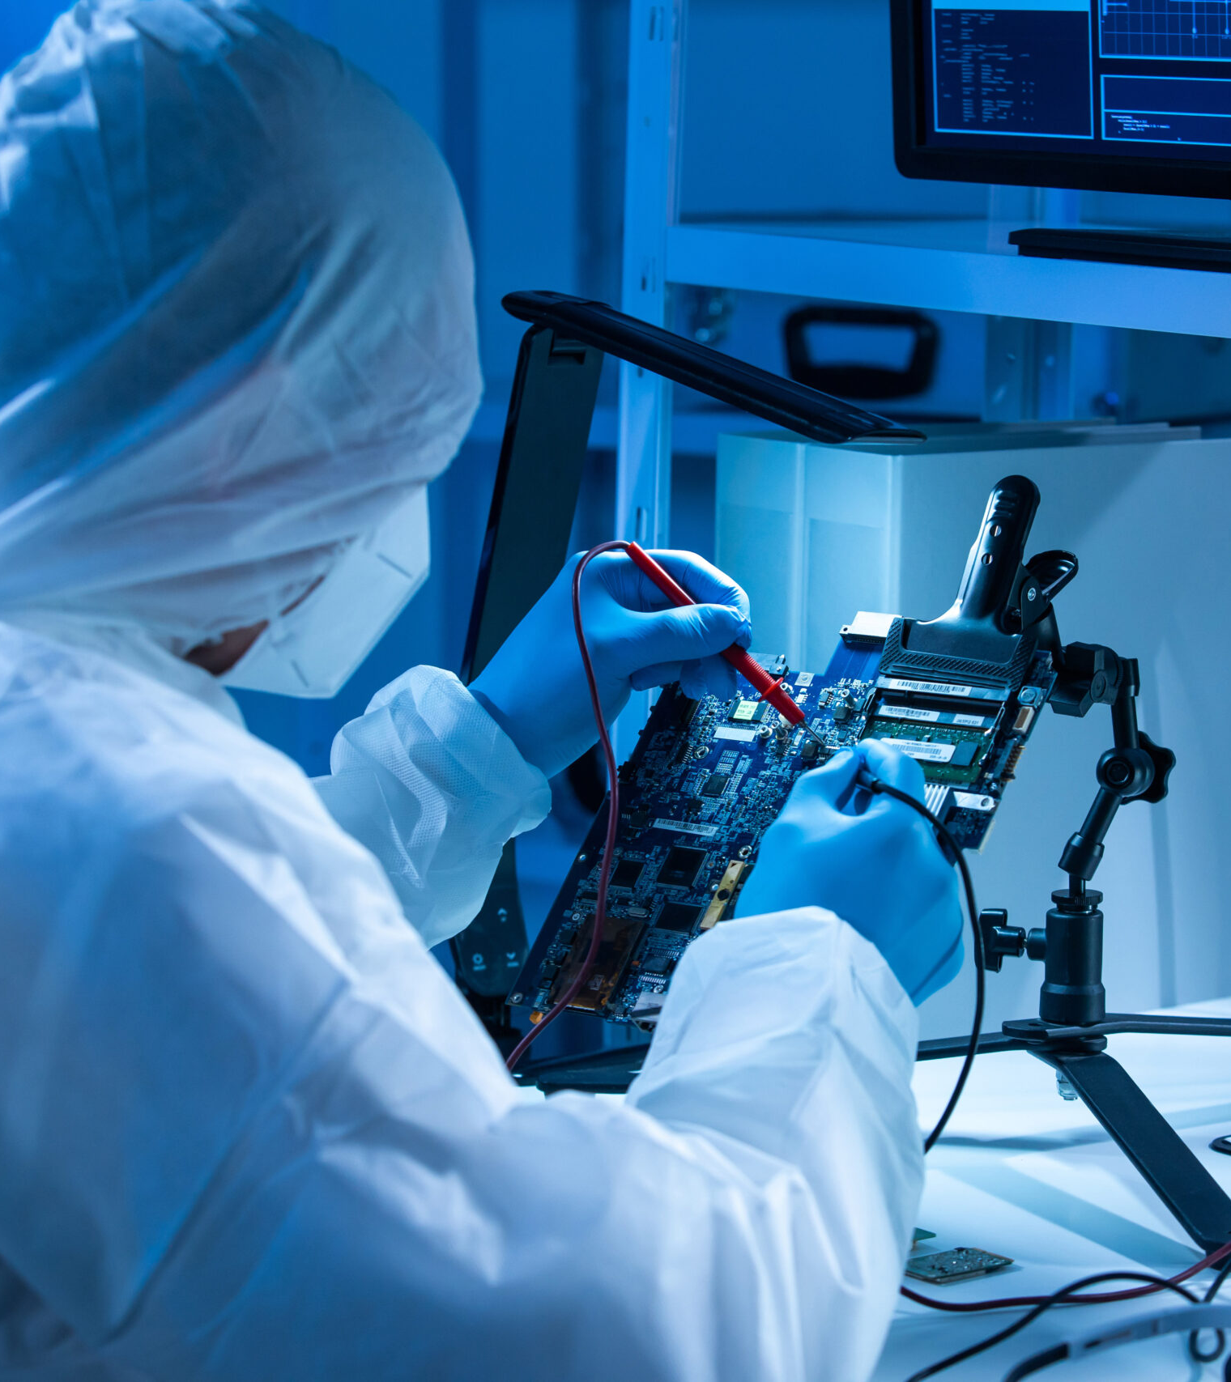
Tokenisation – path to the future investment model
Simon Keefe
Head of Market Solutions
June 2024

Slide 2


Calastone Digital investment platform
Notes:
AGREEMENTS

Slide 3
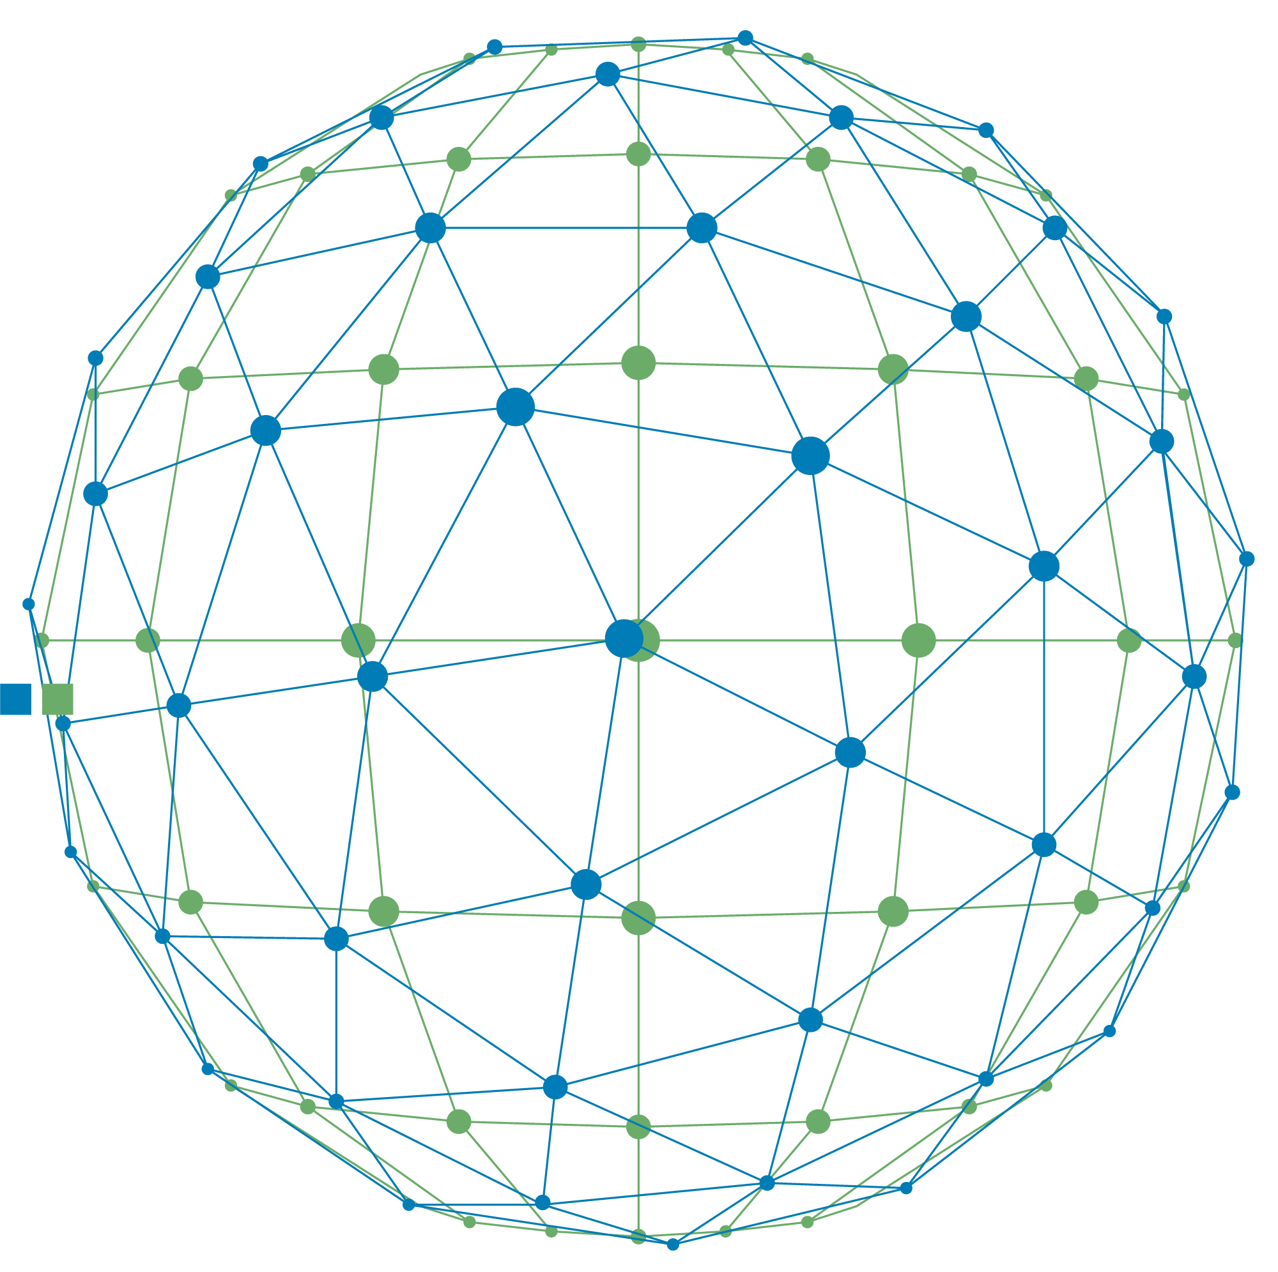
Digital future
LOW-COST
Real-time
Enhanced liquidity
diversify
choice
digital
Personalised
transparency
accessible
connected
secure
Notes:
Start with an abstract globe image and with lines - show the following words/phrases (low cost, digital, enhanced liquidity, transparency, real-time, diversify, personalised, choice, accessible, connected, secure)
Move image 1 to right and reduce size – introduce line/path (a timeline) to show the route to this future

Slide 4
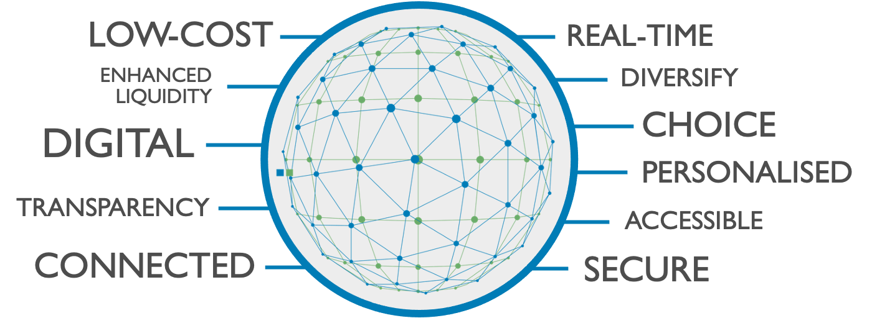
Digital future
Digital Distribution Venues
Collateralisation
REPO
Digital Bonds
Tokenised Infrastructures
CRYPTO
Notes:
Start with an abstract globe image and with lines - show the following words/phrases (low cost, digital, enhanced liquidity, transparency, real-time, diversify, personalised, choice, accessible, connected, secure)
Move image 1 to right and reduce size – introduce line/path (a timeline) to show the route to this future

Slide 5







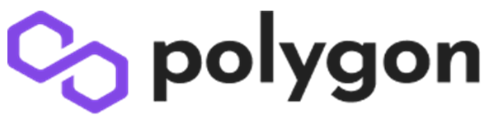












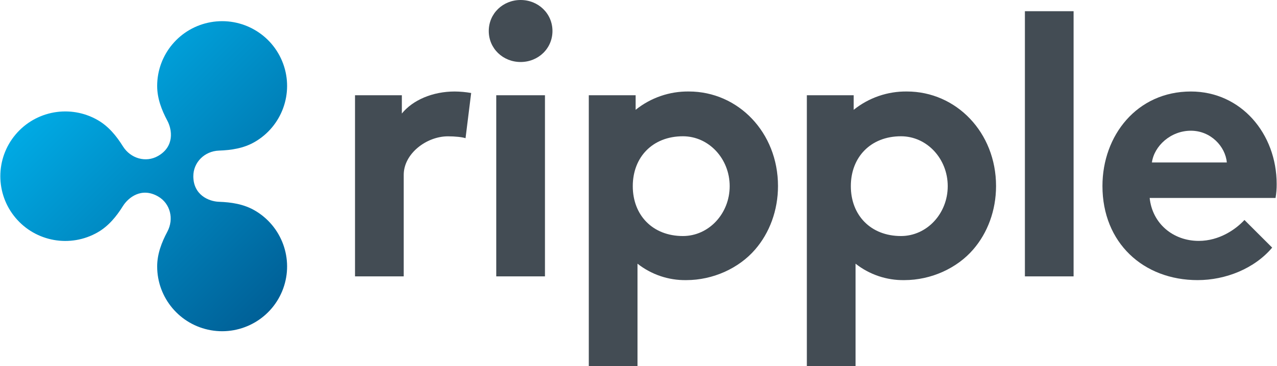





Innovation in action
MANUFACTURERS
INFRASTRUCTURES
DLT FRAMEWORKS

Slide 6
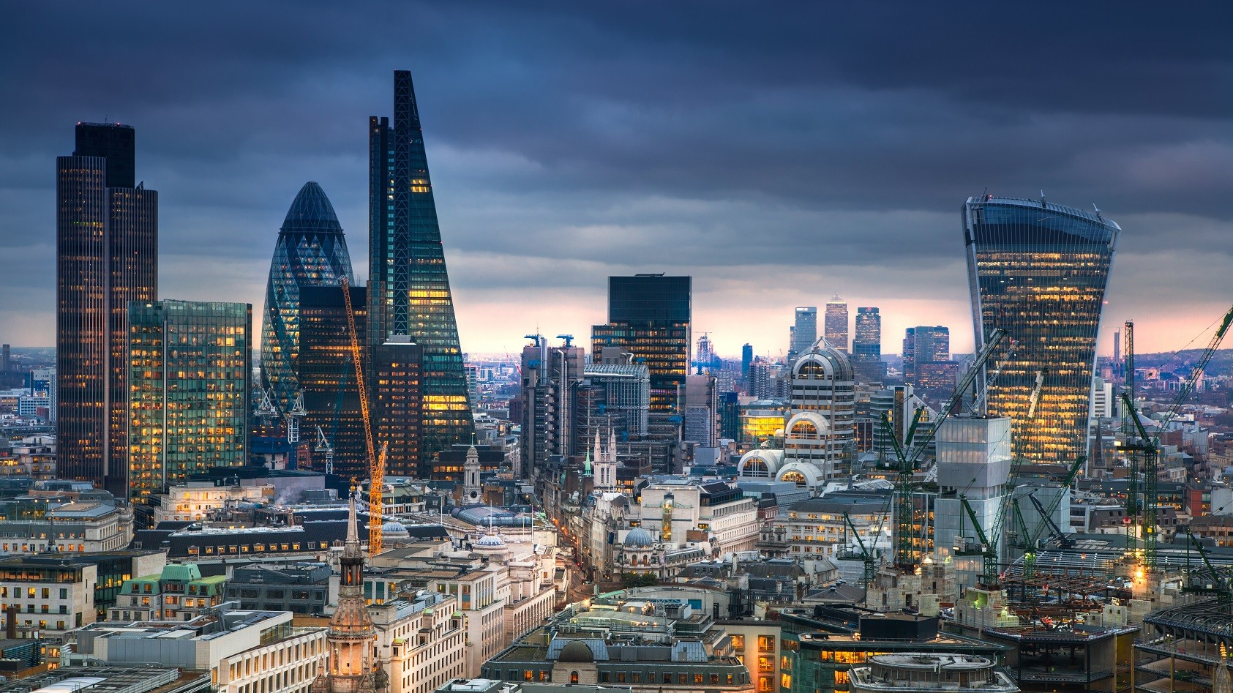
REGULATION
Notes:
Large Word ‘regulation’ over globe image /financial services image (all screen)

Slide 7
The why
PORTFOLIO
EFFICIENCY
administration
TECHNOLOGY
LIQUIDITY
INVESTOR
CHOICE
REAL-TIME
DATA
SETTLEMENT
increased
confidence
COLLABORATION
TRANSPARENT
regulatory
PROTECTION
compliance
global
COST
PERSONALISED
SPEED
Notes:
Image of investors overlayed with word cloud of the benefits of DI – see below as example – can we recreate as more calastone branded / colours.
Key large words should be – efficiency / real-time / choice / transparent / cost / personalised and mix of the words in the chart below.

Slide 8





Emerging new digital distribution venues
Digital versions of European mainstream assets
forecast to reach $16tn opportunity by 2030
SOURCE: BCG
DISTRIBUTION VENUES
DLT FRAMEWORKS
Notes:
Reuse slide 7 from deck 1

Slide 9

THANK YOU
TOKENISATION – PATH TO THE FUTURE INVESTMENT MODEL

