Slide 1

Distribution 3.0 – Accessing the emerging digital distribution venues
Simon Keefe
Head of Market Solutions
June 2024

Slide 2
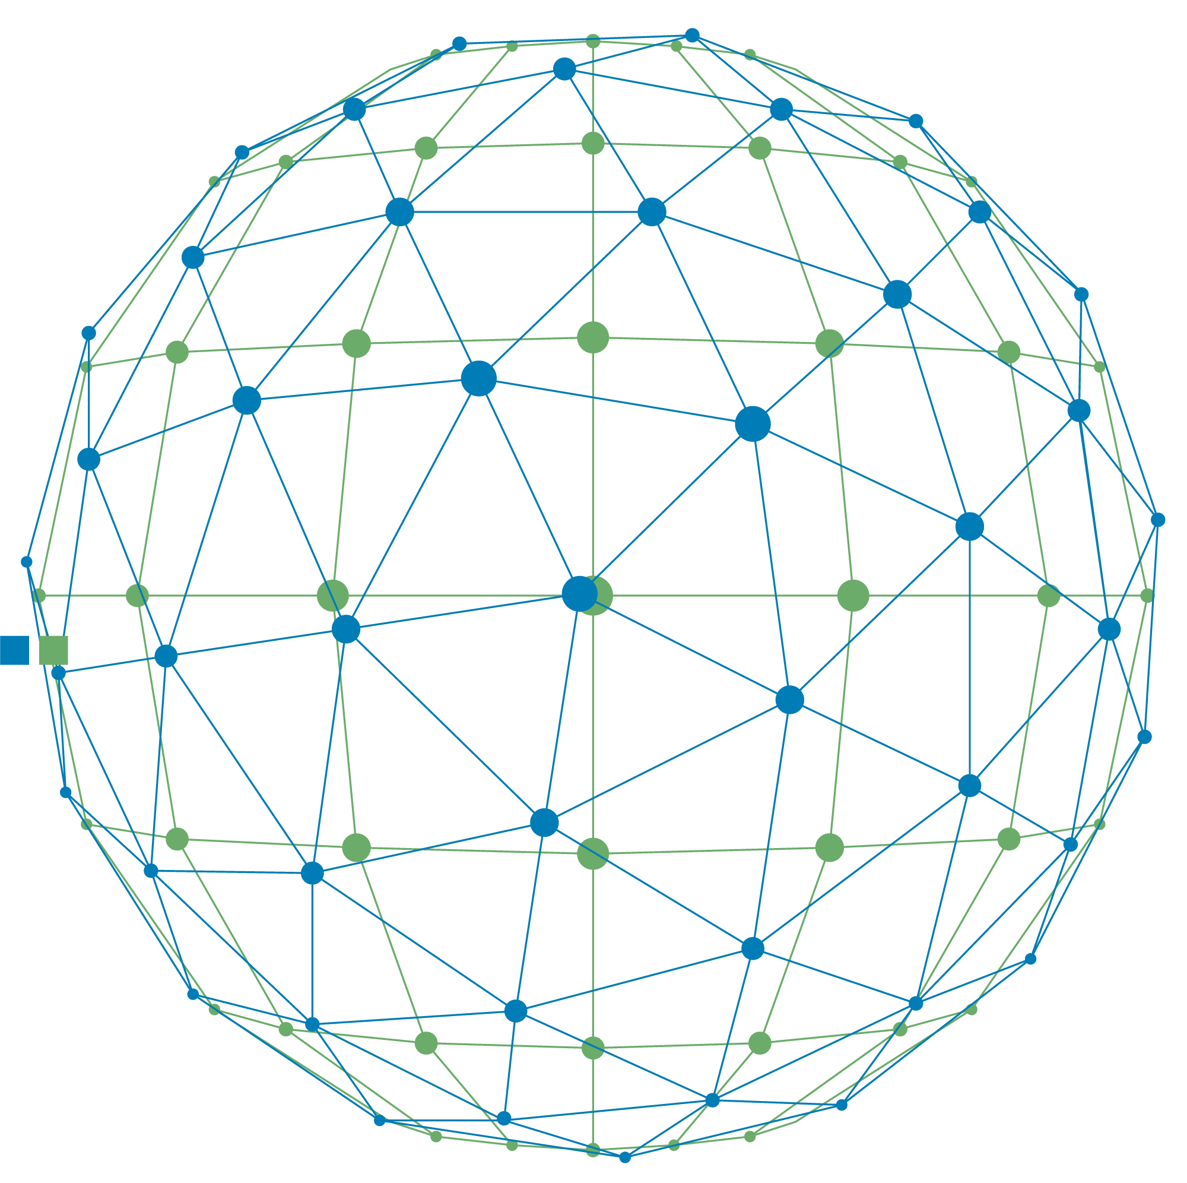
digital distribution
Notes:
Insert ‘future distribution’ over a globe image
Reuse from d1

Slide 3

Evolving investment landscape
Generational transfer of wealth
$162 trillion
transfer forecast between 2024 - 2045

Slide 4
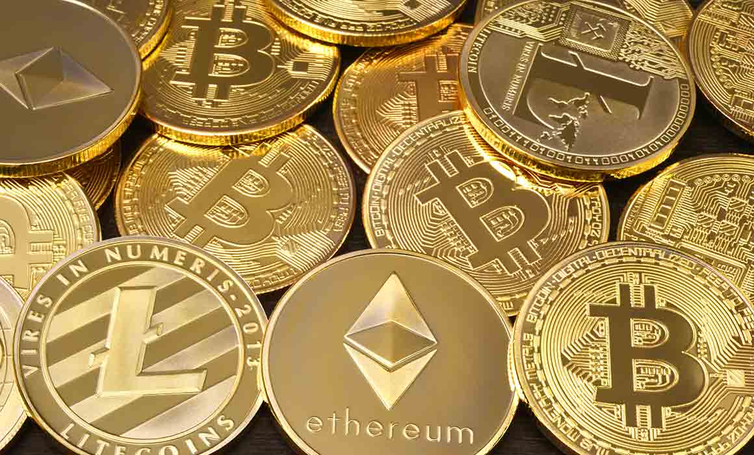
Evolving investment landscape
access TO CRYPTO Investors

Slide 5
Evolving investment landscape
Repo & Collateralisation
Notes:
’Collateralisation’ create image similar to this (see image – a manufacturing image and cash/assets)

Slide 6














Emerging new digital distribution venues
Digital versions of European mainstream assets
forecast to reach $16tn opportunity by 2030
SOURCE: BCG
DISTRIBUTION VENUES
DLT FRAMEWORKS
Notes:
Reuse slide 7 from deck 1

Slide 7
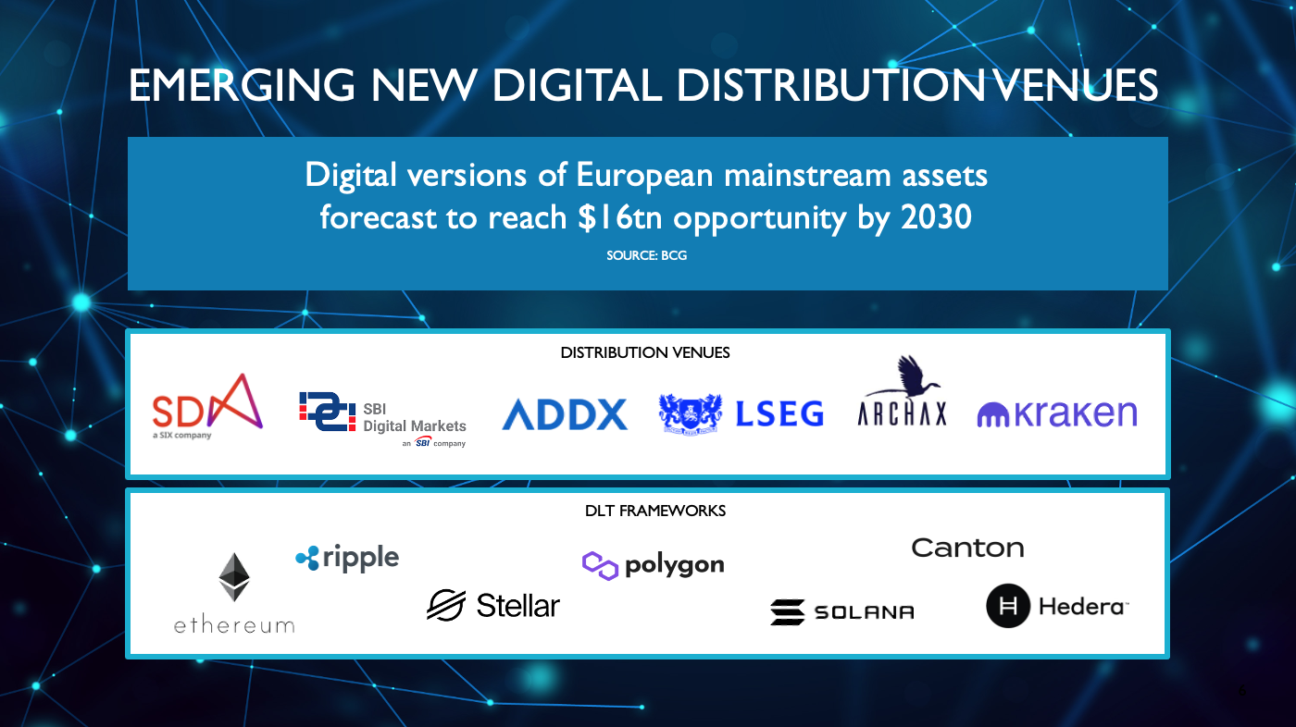
connectivity
natively digital product
backwards compatibility

Slide 8

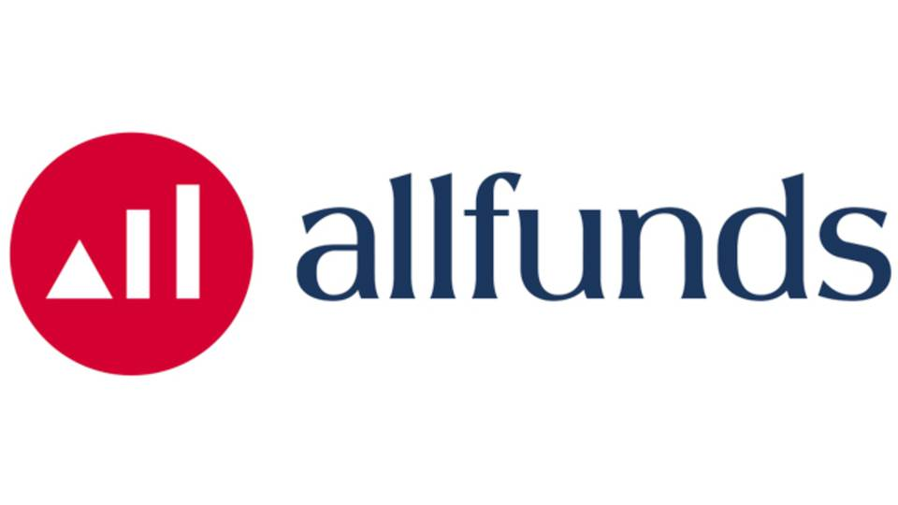

Calastone Digital investments – distribution
FUND DISTRIBUTORS
& PLATFORMS
ASSET SERVICERS
FUND MANAGERS
DISTRIBUTION VENUES
DLT FRAMEWORKS
Notes:
We want to show how our network is extending to include the new digital distribution venues.
As a thought – can we adapt and improve the following slide which I lifted from an old deck. – The corporates/moneymarkets and treasury management can be removed) – the others set out as you think looks best... – Then on click can we drop in the new digital venues and dlts (from deck 1 – logos as below – to show how the network is evolving and extending.

Slide 9
Thank you and links
End slide

